Slide 1
CGB1201 – JAVA PROGRAMMING
END SEMESTER REVIEW
Department of Electrical and Electronics Engineering
Academic Year: 2025 – 2026 (Odd Semester)
Register Number : 927624BEE088
Name : SHAMEEM I
Year : II
Semester : III
Section : EEE-B
Date : 13.12.2025

Slide 2
TITLE
ONLINE AUCTION SYSTEM
CGB1201 – JAVA PROGRAMMING – END SEMESTER REVIEW

Slide 3
Abstract
The Online Auction System is a Java-based web application that allows users to buy and sell products through real-time online bidding. It offers a secure and user-friendly platform where sellers can list items and set auction details, while buyers can place bids and track auctions live. The system features automated auction timing, bid validation, winner selection, and an admin dashboard for managing users and auctions. Built with Java, JSP, and MySQL, it ensures efficient auction management, transparency, and convenience for all users.
CGB1201 – JAVA PROGRAMMING – END SEMESTER REVIEW

Slide 4
Abstract with CO/PO Mapping
Abstract | CO | POs | PSO
The Online Auction System is a Java-based web application that allows users to buy and sell products through real-time online bidding. It offers a secure and user-friendly platform where sellers can list items and set auction details, while buyers can place bids and track auctions live. The system features automated auction timing, bid validation, winner selection, and an admin dashboard for managing users and auctions. Built with Java, JSP, and MySQL, it ensures efficient auction management, transparency, and convenience for all users. | CO1 CO3 CO4 | PO1 PO2 PO3 PO4 PO5 PO6 PO7 PO8 PO9 PO10 PO12 | PSO1 PSO2
CGB1201 – JAVA PROGRAMMING – END SEMESTER REVIEW

Slide 5
Introduction
This Online Auction System project in Java is a simple application that allows users to buy and sell products through online bidding. It has two main parts: an admin panel where sellers add items and start auctions with a timer, and a customer panel where buyers place bids on products. The system keeps track of all bids, shows the highest bid in real-time, and automatically saves the winner when the auction time ends. The project uses Java Swing for a graphical user interface and connects to a database to store auction details, making online auctions easy and efficient.
CGB1201 – JAVA PROGRAMMING – END SEMESTER REVIEW

Slide 6
Java Programming - Concepts Used
Object-Oriented Programming (OOP): Classes and objects encapsulate auction items, users, bids, and system functions.
Swing GUI: Java Swing is used to build the graphical user interface for admin and customer panels.
Event Handling: To manage user actions like button clicks, bid submissions, and auction timers.
Multithreading: For running auction timers and managing concurrent bids smoothly.
Basic Java Syntax: Control statements, loops, and data types used throughout for program logic.
CGB1201 – JAVA PROGRAMMING – END SEMESTER REVIEW

Slide 7
Java Programming - Concepts Used
Exception Handling: To manage runtime errors and ensure smooth execution.
Collections Framework: To store and manage lists of items, users, and bids efficiently.
File I/O: Used for logging or configuration storage outside the database
CGB1201 – JAVA PROGRAMMING – END SEMESTER REVIEW

Slide 8
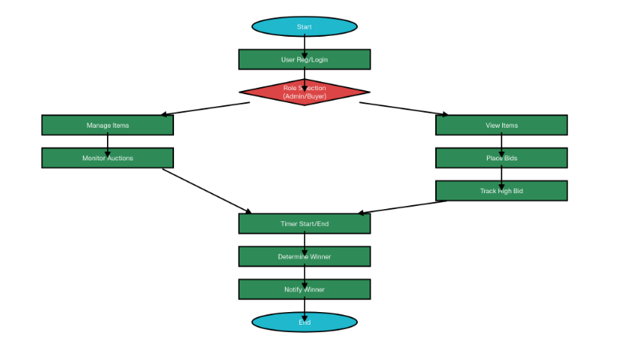
Proposed Architecture
CGB1201 – JAVA PROGRAMMING – END SEMESTER REVIEW

Slide 9
Proposed Architecture - Description
Start: The beginning of the auction system process where the application is launched.
User Registration/Login: Users create an account or log in to access the system securely.
User Role Selection (Admin or Buyer): Users choose their role—either an admin who manages auctions or a buyer who places bids.
Admin - Manage Items: Admin can add new items for auction, edit existing items, or delete items no longer available.
Admin - Monitor Auctions: Admin oversees ongoing auctions to ensure smooth operation and management.
Buyer - View Auction Items: Buyers browse through the list of available auction items.
CGB1201 – JAVA PROGRAMMING – END SEMESTER REVIEW

Slide 10
Proposed Architecture - Description
Buyer - Place Bids: Buyers submit their bids on auction items they are interested in.
Buyer - Track Highest Bid: Buyers can see the current highest bid in real-time to make competitive bids.
Auction Timer Starts: The auction timer begins counting down the time allotted for bidding on an item.
Auction Timer Ends: The bidding time expires, and no further bids are accepted.
Determine Auction Winner: The system identifies the highest bidder as the winner of the auction.
Notify Winner: The winning bidder is notified about their success and further steps.
End: The auction process concludes until the next auction cycle begins.
CGB1201 – JAVA PROGRAMMING – END SEMESTER REVIEW

Slide 11
List of Modules
User Management Module:
The User Management Module is responsible for handling all user-related activities in the system. It allows new users to register, existing users to log in securely, and ensures that only authorized users can access specific features based on their roles such as buyer, seller, or admin. It also manages user authentication, password protection, and account details, ensuring a safe and personalized experience for every user interacting with the system.
CGB1201 – JAVA PROGRAMMING – END SEMESTER REVIEW

Slide 12
List of Modules
Auction and Item Management Module:
The Auction and Item Management Module focuses on managing auction items and controlling the auction process. It allows sellers or admins to add, edit, or remove products that are available for auction. This module sets the auction duration, starting price, and monitors the auction status from start to end. It also ensures that auctions run smoothly within the given time frame and maintains transparency in the process by displaying item details and current bidding information to all users.
CGB1201 – JAVA PROGRAMMING – END SEMESTER REVIEW

Slide 13
List of Modules
Bidding Module:
The Bidding Module handles the process of placing and managing bids on auction items. It allows buyers to place bids on active auctions, checks that each new bid is higher than the previous one, and updates the current highest bid in real time. This module ensures fair competition among bidders and automatically declares the highest bidder as the winner once the auction ends. It plays a key role in maintaining the integrity and excitement of the online auction process.
CGB1201 – JAVA PROGRAMMING – END SEMESTER REVIEW

Slide 14
List of Modules
Database Module:
The Database Module is responsible for storing, retrieving, and managing all data used in the system. It securely maintains records of users, auction items, bids, and results in a structured way using a database such as MySQL. This module ensures data consistency, fast access, and reliable updates during transactions, making the system efficient and stable. It serves as the backbone of the entire application by connecting all modules and managing the flow of information between them.
CGB1201 – JAVA PROGRAMMING – END SEMESTER REVIEW

Slide 15
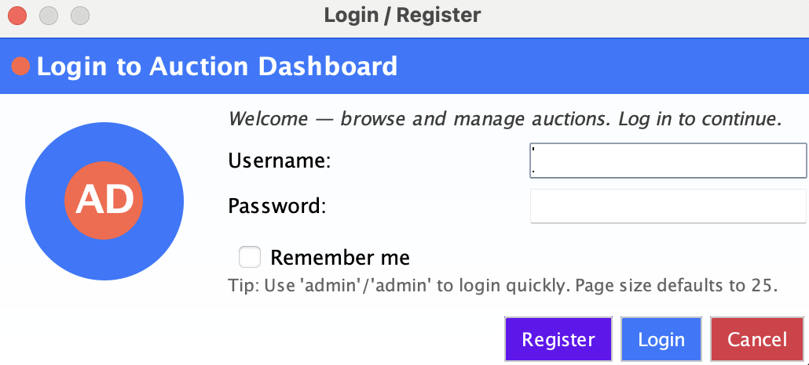
Output
Authentication Interface (Login / Register) :
CGB1201 – JAVA PROGRAMMING – END SEMESTER REVIEW

Slide 16
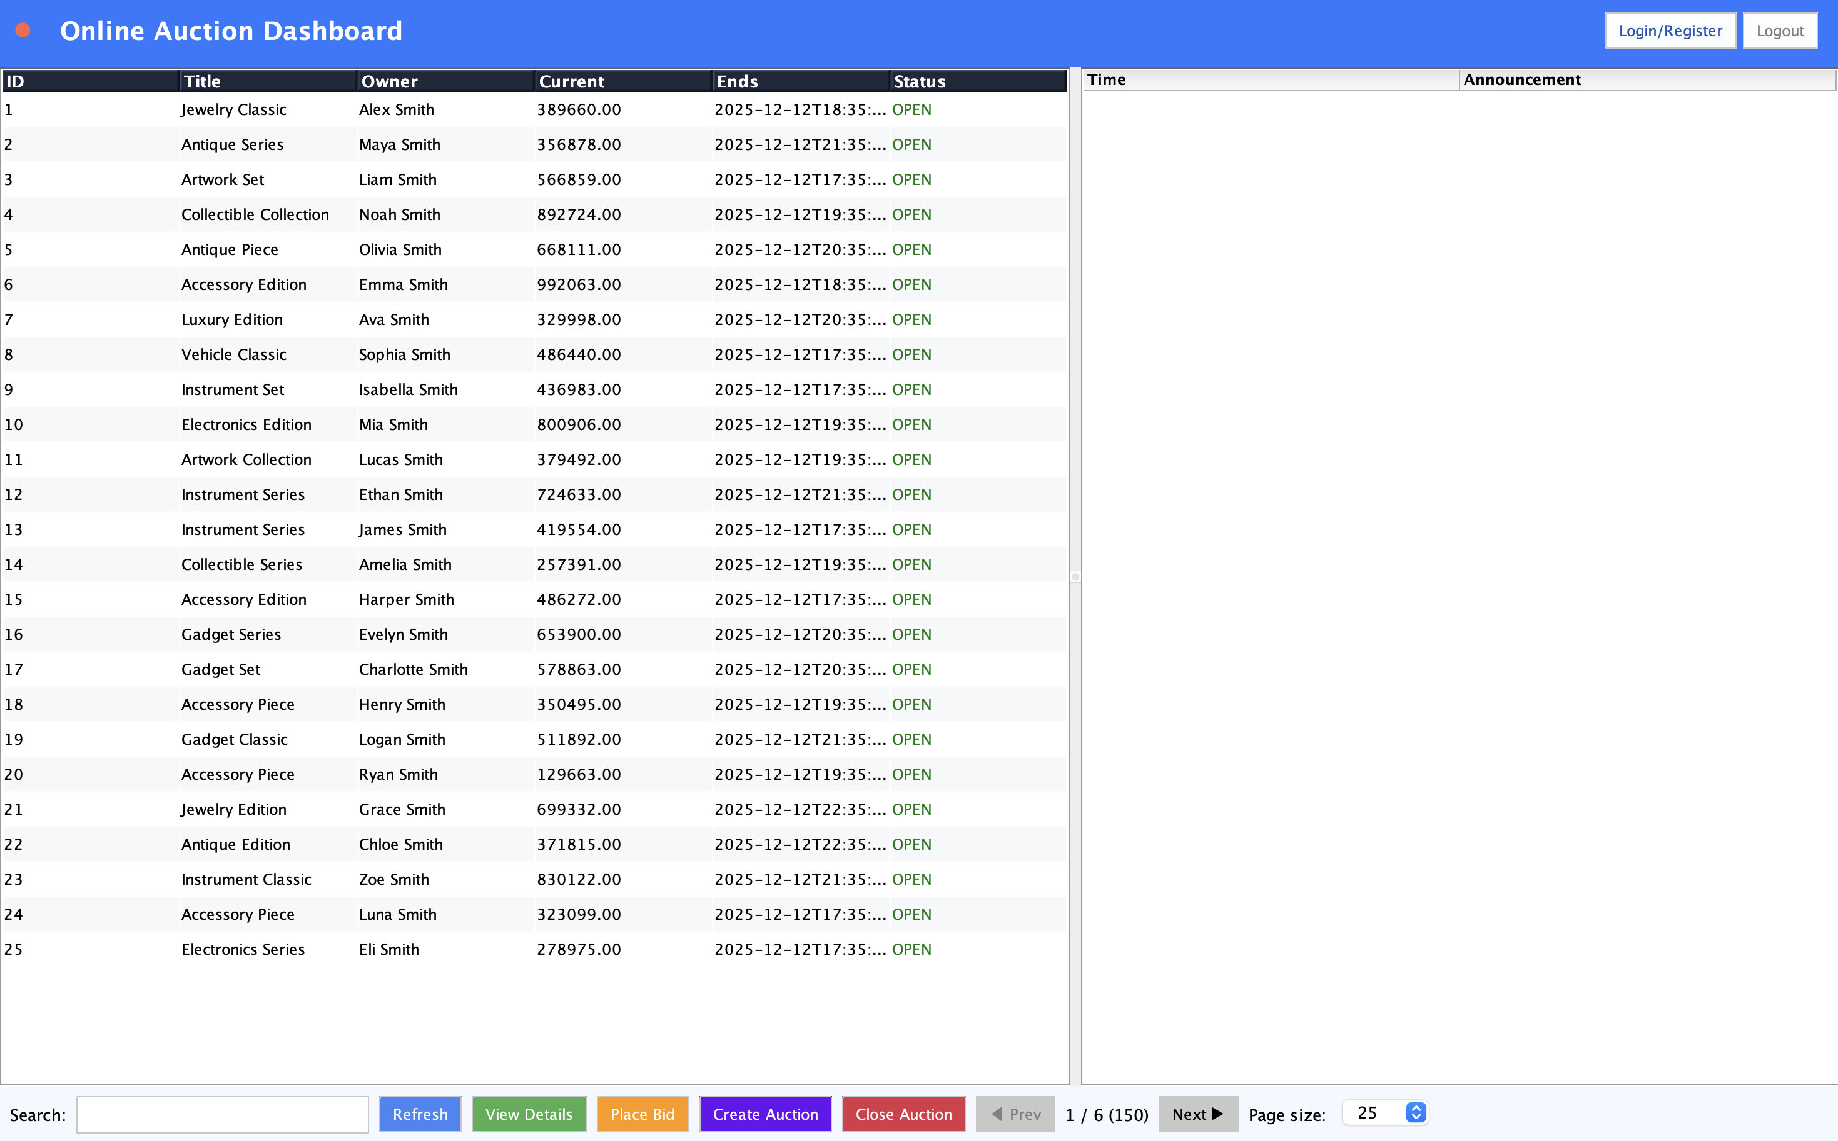
Output
Online Auction Dashboard:
CGB1201 – JAVA PROGRAMMING – END SEMESTER REVIEW

Slide 17
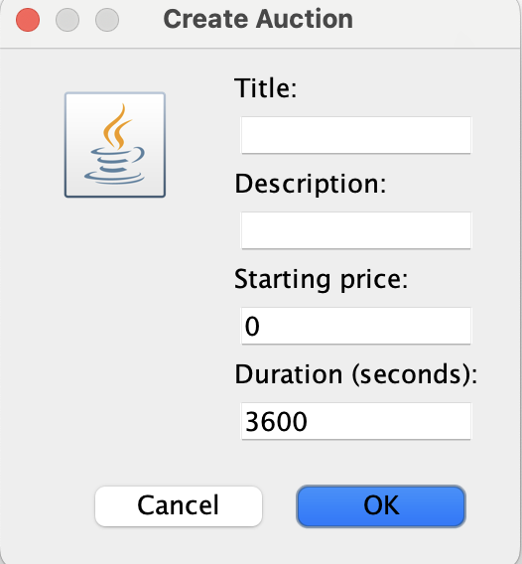
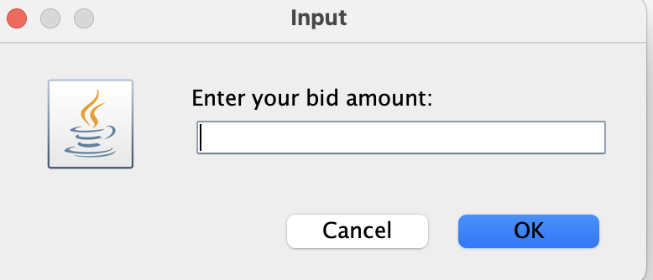
Output
Creating a New Auction:
Bidding Interface :
CGB1201 – JAVA PROGRAMMING – END SEMESTER REVIEW

Slide 18
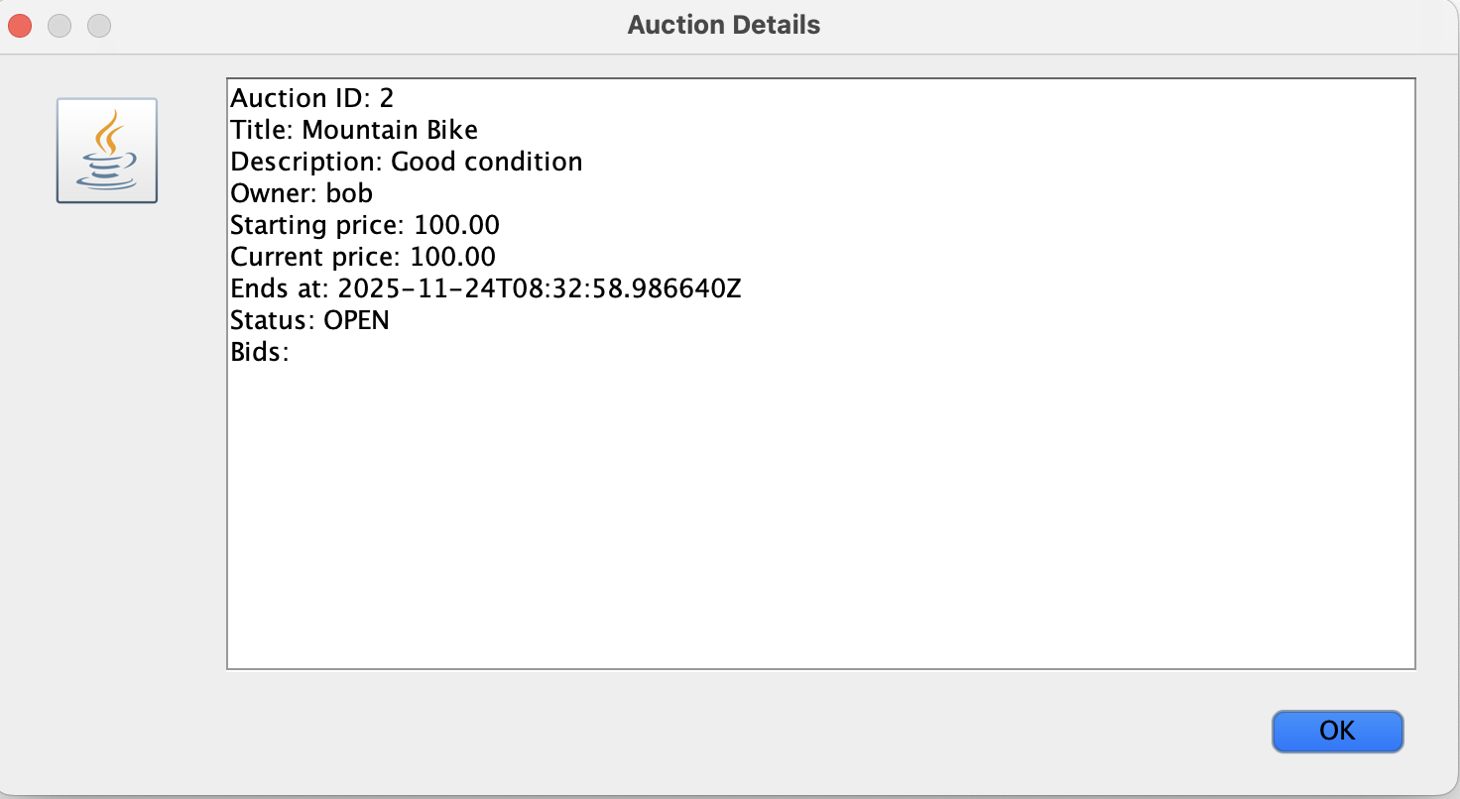
Output
Auction Details View :
CGB1201 – JAVA PROGRAMMING – END SEMESTER REVIEW

Slide 19
Thank You
ANY QUERIES ?
CGB1201 – JAVA PROGRAMMING – END SEMESTER REVIEW

